Slide 1

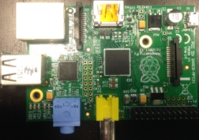
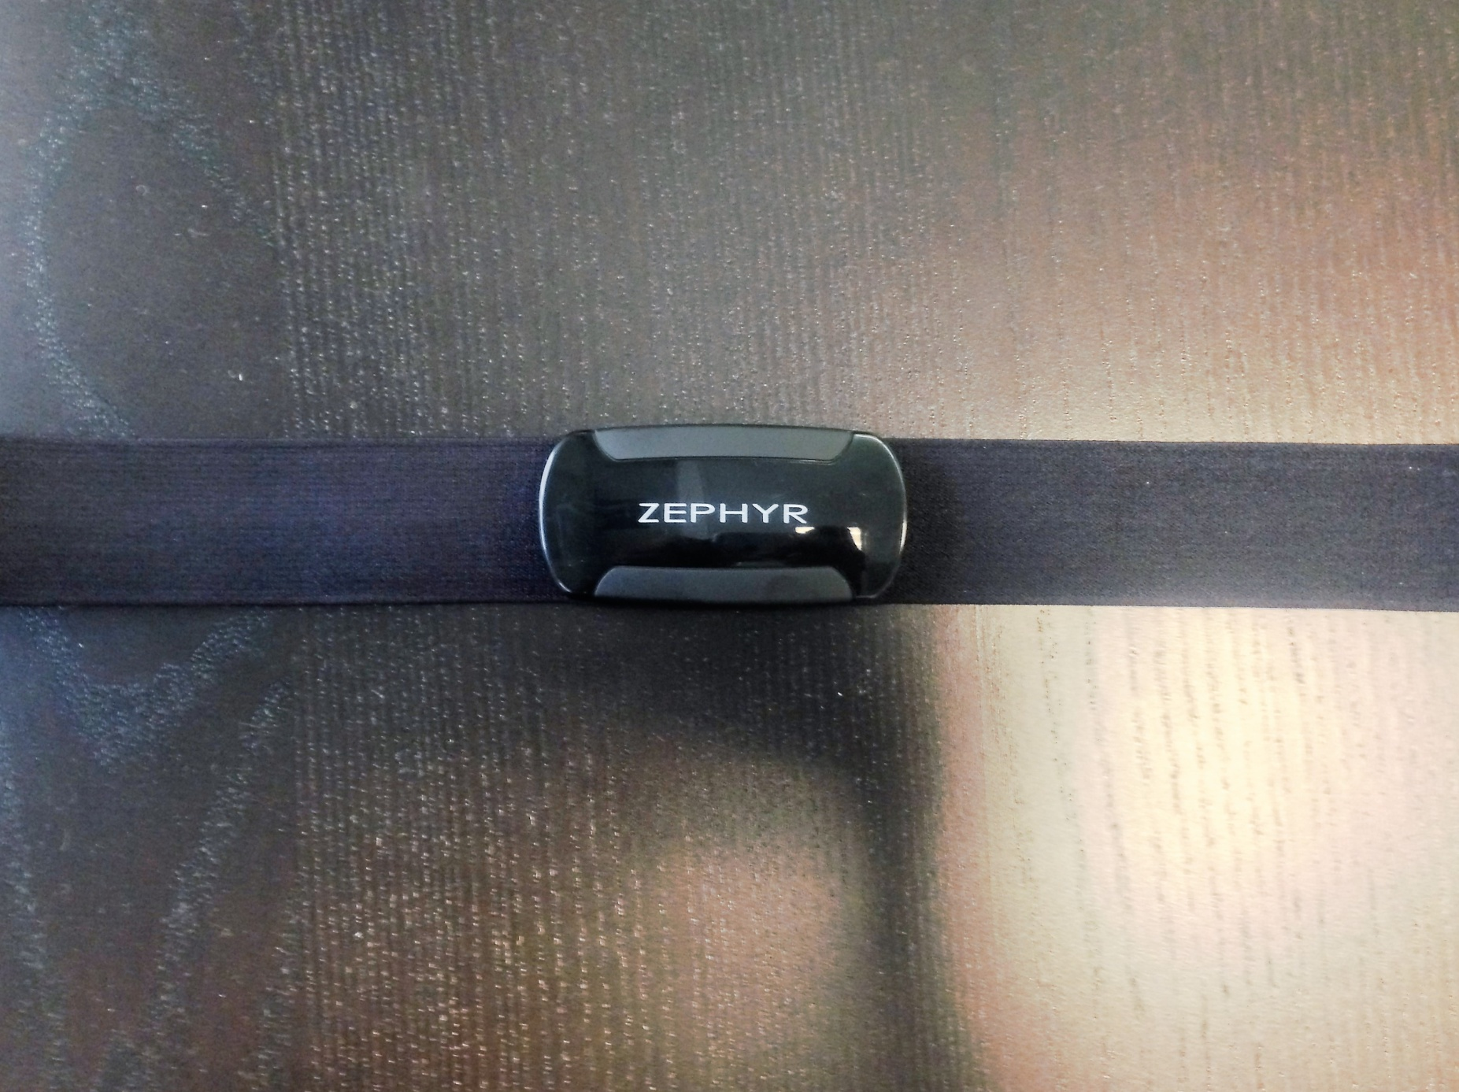


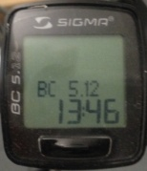
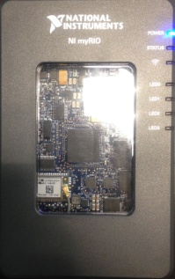
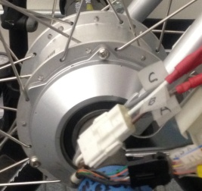
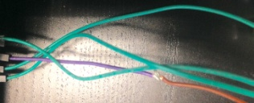
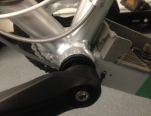
User’s heart rate increases
Zephyr heart rate monitor collects data
Sends data over Bluetooth
Bluetooth receiver inputs data to Raspberry Pi
Data is converted to hexadecimal
Speedometer collects data
Torque sensor collects data
Torque
commands transferred through jumper cables
Data transferred through jumper cables
Motor applies assistive torque
myRIO analyzes data

